Slide 1
Game research

Slide 2

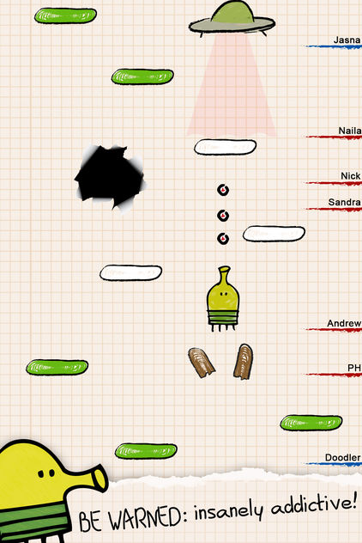
DOODLE JUMP
Doodle Jump
Platformer
Replaces traditional movement mechanics with gyroscope controls and automatic jumping, limiting player choice

Slide 4
Game ideas

Slide 5
IDEA 1 Platformer with no jumping
Genre: Platformer
Mechanic removed: Jumping
New solutions
Players must grow a beanstalk to the correct size in order to allow them to cross gaps between platforms
Length can either depend on the number of beans supplied to the planting patch or the amount of time the player waters the sprout for
If the beanstalk if too short, the player will fall to their death
If the beanstalk is too long, it will grow into the platform and make it break

Slide 6
IDEA 2 Stealth game with no player movement
Genre: Stealth
Mechanic removed: Character movement
New solution
The player must manipulate the environment around them to stay hidden
The game features AI and works on a turn-based system where the player will move the environment and then the AI will take a turn to move
Could create some movement constraints based on testing
The game could also work in real-time, with AI/environment being moved constantly
Notes:
Stealth game where the character doesn’t move so they have to manipulate the environment around them
Turn based, you move a piece of the environment and then the AI moves

Slide 7
IDEA 3

